Slide 1

Data Cleaning in CLHLS: practice in STATA and R
Xian Zhang

Slide 2
Before you do Data Cleaning…
You need to know the data you need for analyses:
1. What study sample?
2. What are the X, Y, Z variables?
3. What data structure?
4. *What data distribution?

Slide 3
Outline
1. Generate X, Y, and Z variables
2. Prepare data structure
3. Adjust the distribution
4. Identify sample
5. Prepare the final dataset
Notes:
这个过程中会发生什么步骤

Slide 4
1. Generate X, Y, and Z variables
To study…
Exposure,
Outcome,
Covariance
Measured by…
X variables,
Y variables,
Z variables

Slide 5
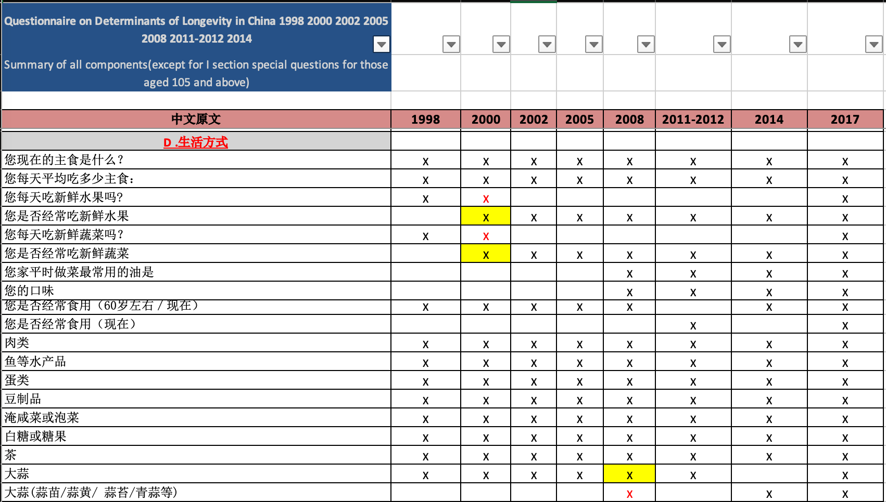
1.1.1 Find proper measures for X, Y, and Z: Variable list
Box-Box/Healthy Aging - CLHLS - NEW/A01 Introduction folder for CLHLS/ 5 CLHLS Data Component All year summary(1998-2017) .xlsx
To study…
Dietary habit

Slide 6
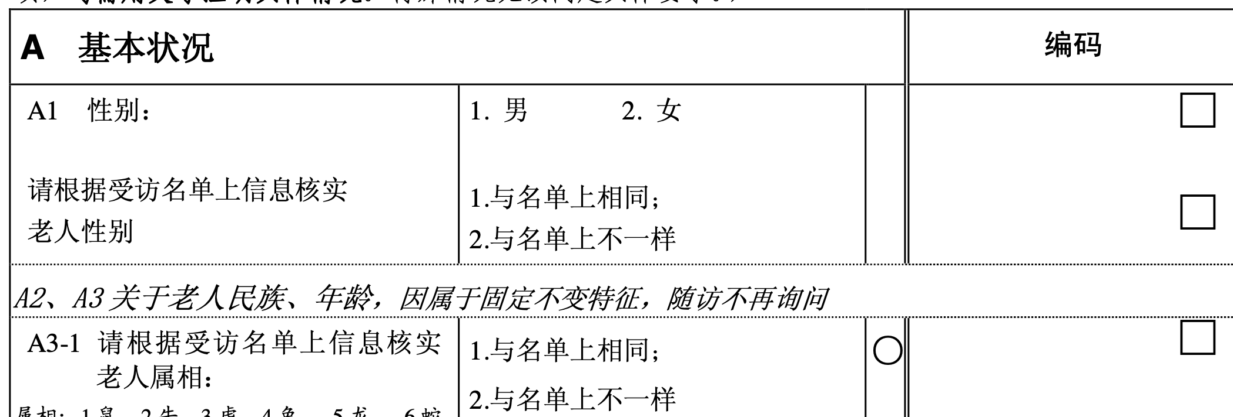
1.1.2 Find proper measures for X, Y, and Z:
Questionnaire
“Box-Box/Healthy Aging - CLHLS - NEW/A02 CLHLS Original data and codebooks/1 Stata/1 Survey Data, questionnaire, and codebook/Questionaire_Chinese version” & “Questionaire_English version”

Slide 7
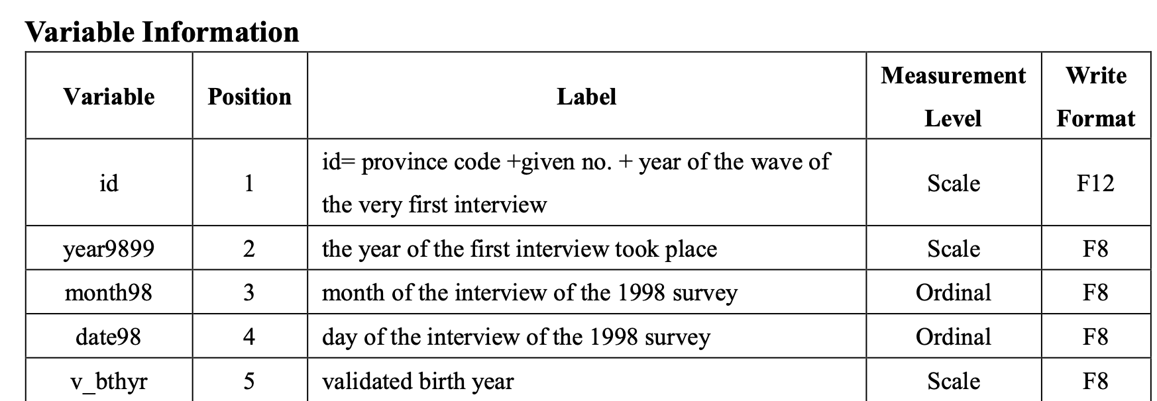
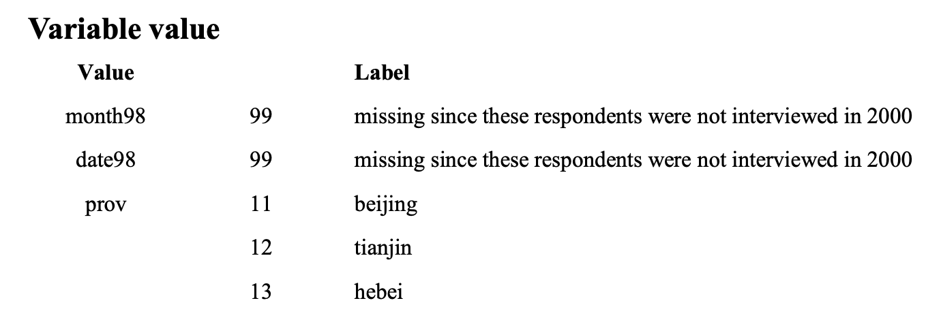
1.2 Observe X, Y, and Z variables: Codebook
*“Box-Box/Healthy Aging - CLHLS - NEW/A02 CLHLS Original data and codebooks/1 Stata/1 Survey Data, questionnaire, and codebook/Cross-sectional codebooks”& “../Longitudinal codebooks”

Slide 8
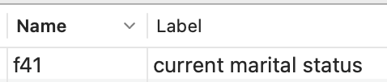
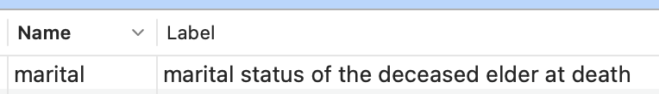
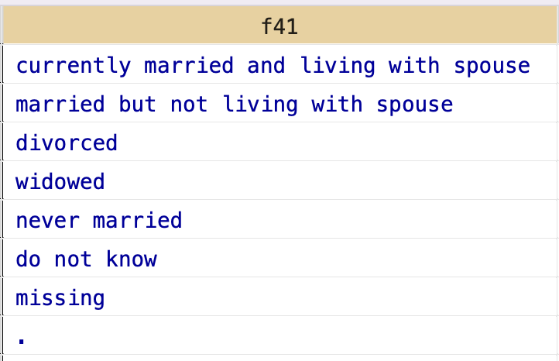
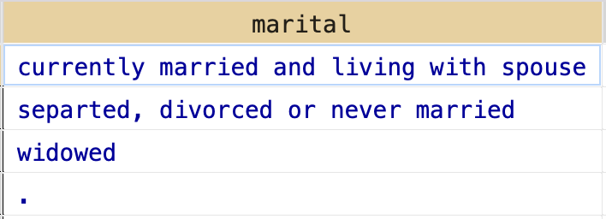
1.3 Generate X, Y, and Z variables
Rename
Recode
Label

Slide 9
2. Prepare data structure
0. What variables uniquely identify the dataset?
Data Structure: cross-sectional, mixed cross-sectional, longitudinal

Slide 10
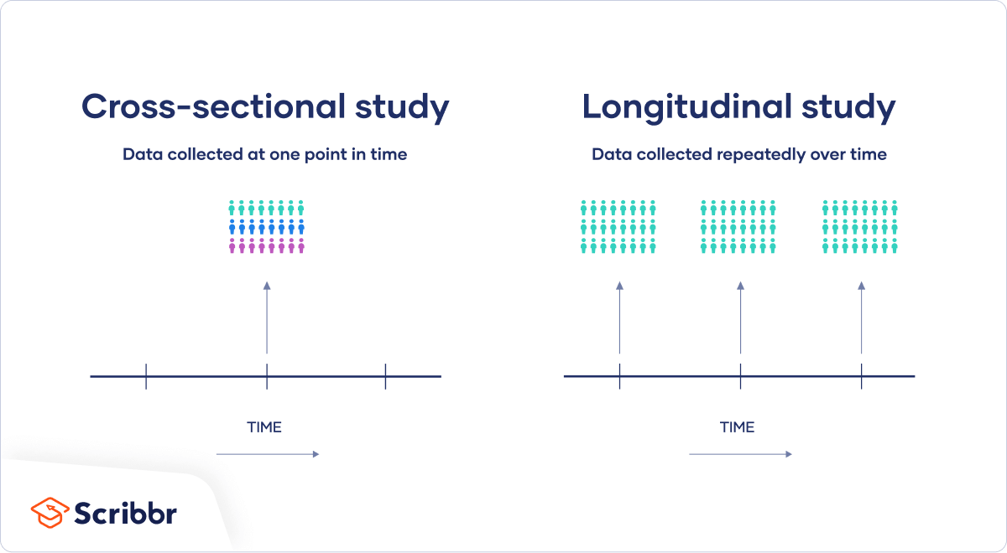
2.1 Data Structure: General
Mixed cross-sectional Study

Slide 11
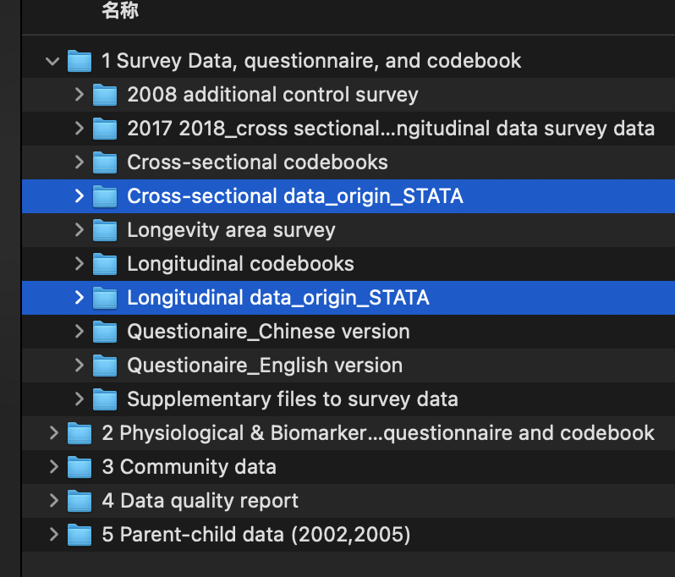
2.2 Data strucutre in CLHLS
Box/Healthy Aging - CLHLS - NEW/A02 Recoded Data and Code/1 Stata/”

Slide 12
2.3.1 Different versions of datasets

Slide 13
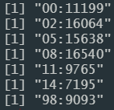
2.3.1 Different versions of datasets
Cross-sectional dataset: https://duke.app.box.com/folder/139686926006

Slide 14
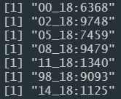
2.3.1 Different versions of datasets
Longitudinal recoded dataset with survival time:
https://duke.app.box.com/folder/139686071322

Slide 15
2.3.2 Cleaned Version
/Users/x152/Library/CloudStorage/Box-Box/HALSA-Healthy Aging - CLHLS/A03 Recoded Data and Code/1 Stata/Data with Covariant/
Cross-sectional data: Base_CLHLS_covariants.dta
Longitudinal data: Panel_CLHLS_f7_covariants.dta

Slide 16
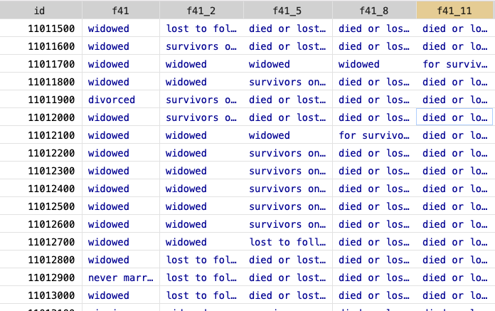
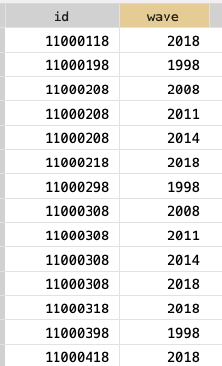
2.4.1 Prepare data structure：Longitudinal Dataset
Long:
id and wave uniquely identify data
Wide:
id uniquely identify data

Slide 17
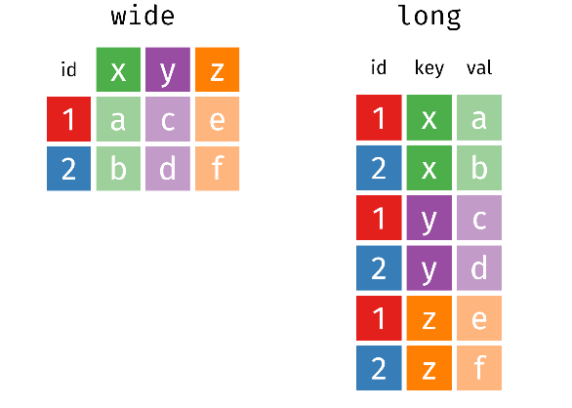
2.4.2 Prepare data structure：Reshape Longitudinal Dataset
https://github.com/gadenbuie/tidyexplain
https://tidyr.tidyverse.org/

Slide 18
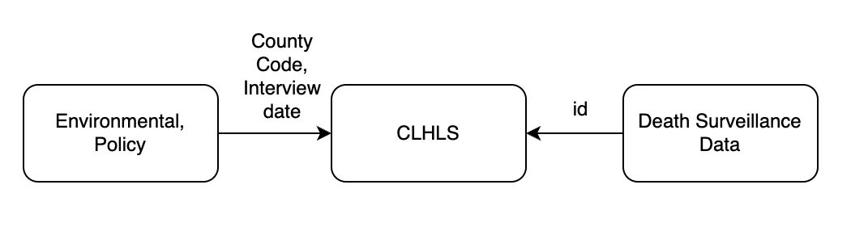
2.5 Combine data

Slide 19
https://github.com/gadenbuie/tidyexplain
2.5 Combine data: merge

Slide 20
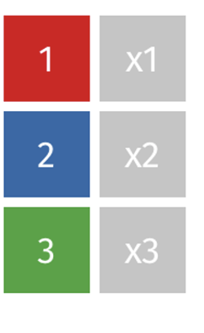
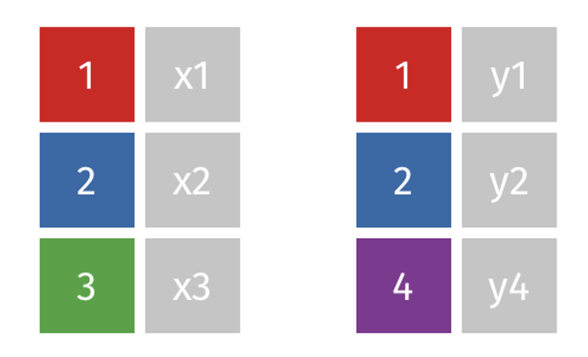
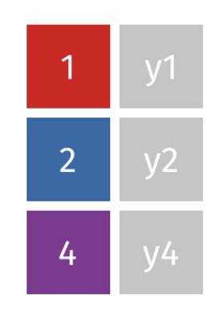
https://github.com/gadenbuie/tidyexplain
2.6 Combine data: append

Slide 21
3. Adjust distribution
Missing value
Outliers
*Distribution

Slide 22
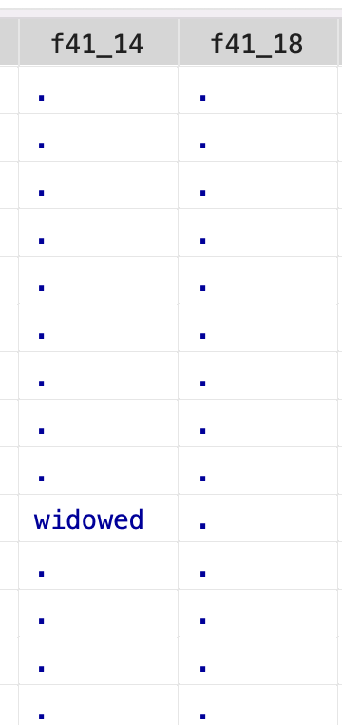
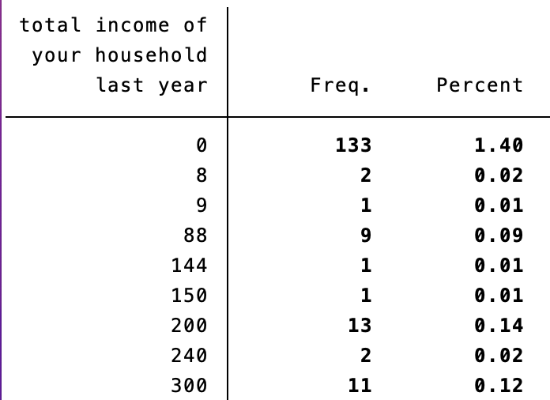
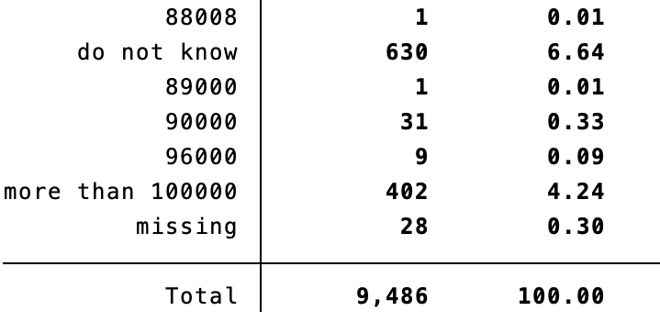
3.1 Missing value
1. Missing value coded
2. Null
3. Abnormal
a2: ethnic group | 1 han 2 hui 3 zhuang 4 yao 5 korea 6 man 7 mongolia 8 others 9 missing
f1: years of schooling | 88 don’t know 99 missing

Slide 23
3.1 Deal with missing values: by assumption
Missing Completely at Random: the missingness of the data is unrelated to both observed and unobserved data.
Drop samples that have missing values.
Multiple Imputation.
2. Missing at Random: the missingness of the data is related to the observed data but not to any unobserved data:
1. Add those observed data as covariates.
2. Multiple Imputation.
3. Missing Not at Random: the missingness of the data is related to unobserved data

Slide 24
3.2 Outliers: identify outliers
By statistic test:
Standard Deviation Rule: data point is more than two or three standard deviations away from the mean
Interquartile Range (IQR) Method: the first quartile (Q1) and the third quartile (Q3) are calculated, let interquartile range IQR = Q3 - Q1. Data points below Q1 - 1.5 * IQR or above Q3 + 1.5 * IQR are often considered outliers.
By theory: e.g. For chronic disease medication, prescriptions should not exceed 90 days per issuance.

Slide 25
3.3 Outliers: deal with
Drop the outliers.
Capping: setting the outliers to a specified percentile of the data
Transformation: Apply a mathematical transformation to reduce the skewness brought about by outliers.

Slide 26
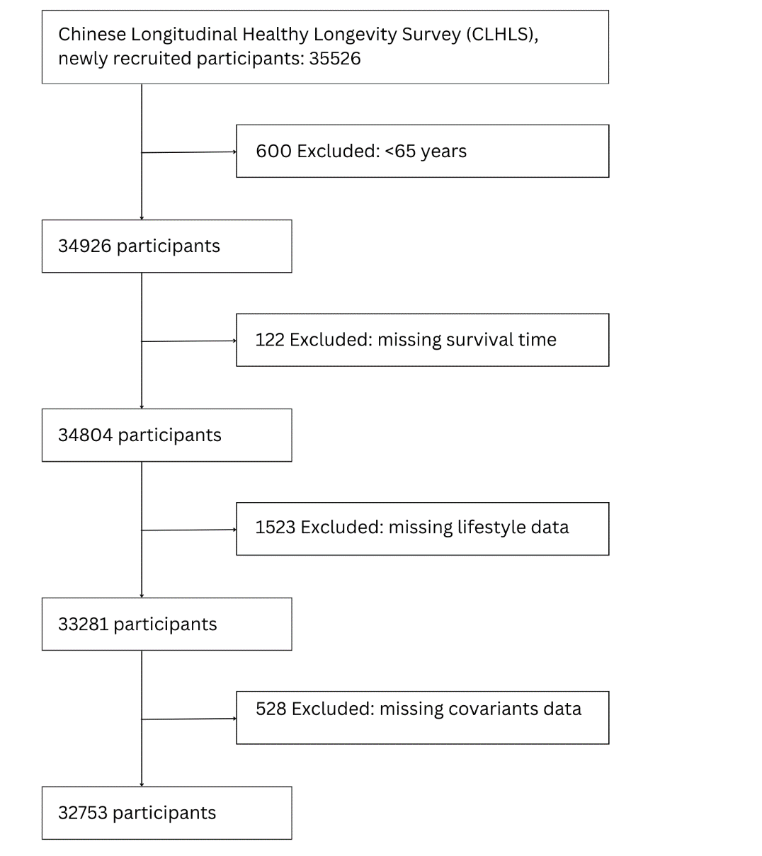
4. Identify Sample

Slide 27
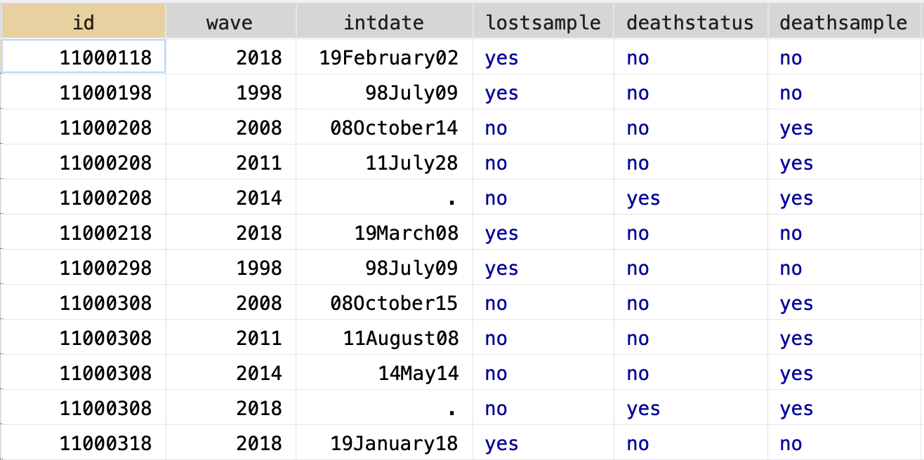
5. Prepare final dataset
Keep what you need
Order and sort the variables

Slide 28
THANK YOU FOR LISTENING

